Slide 1
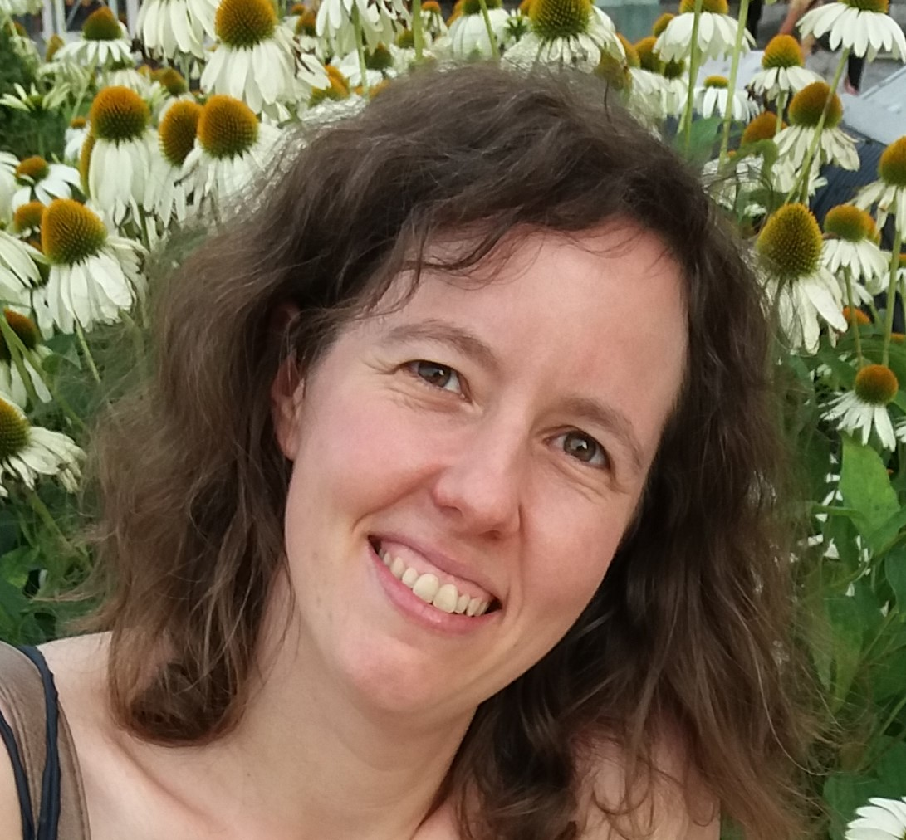
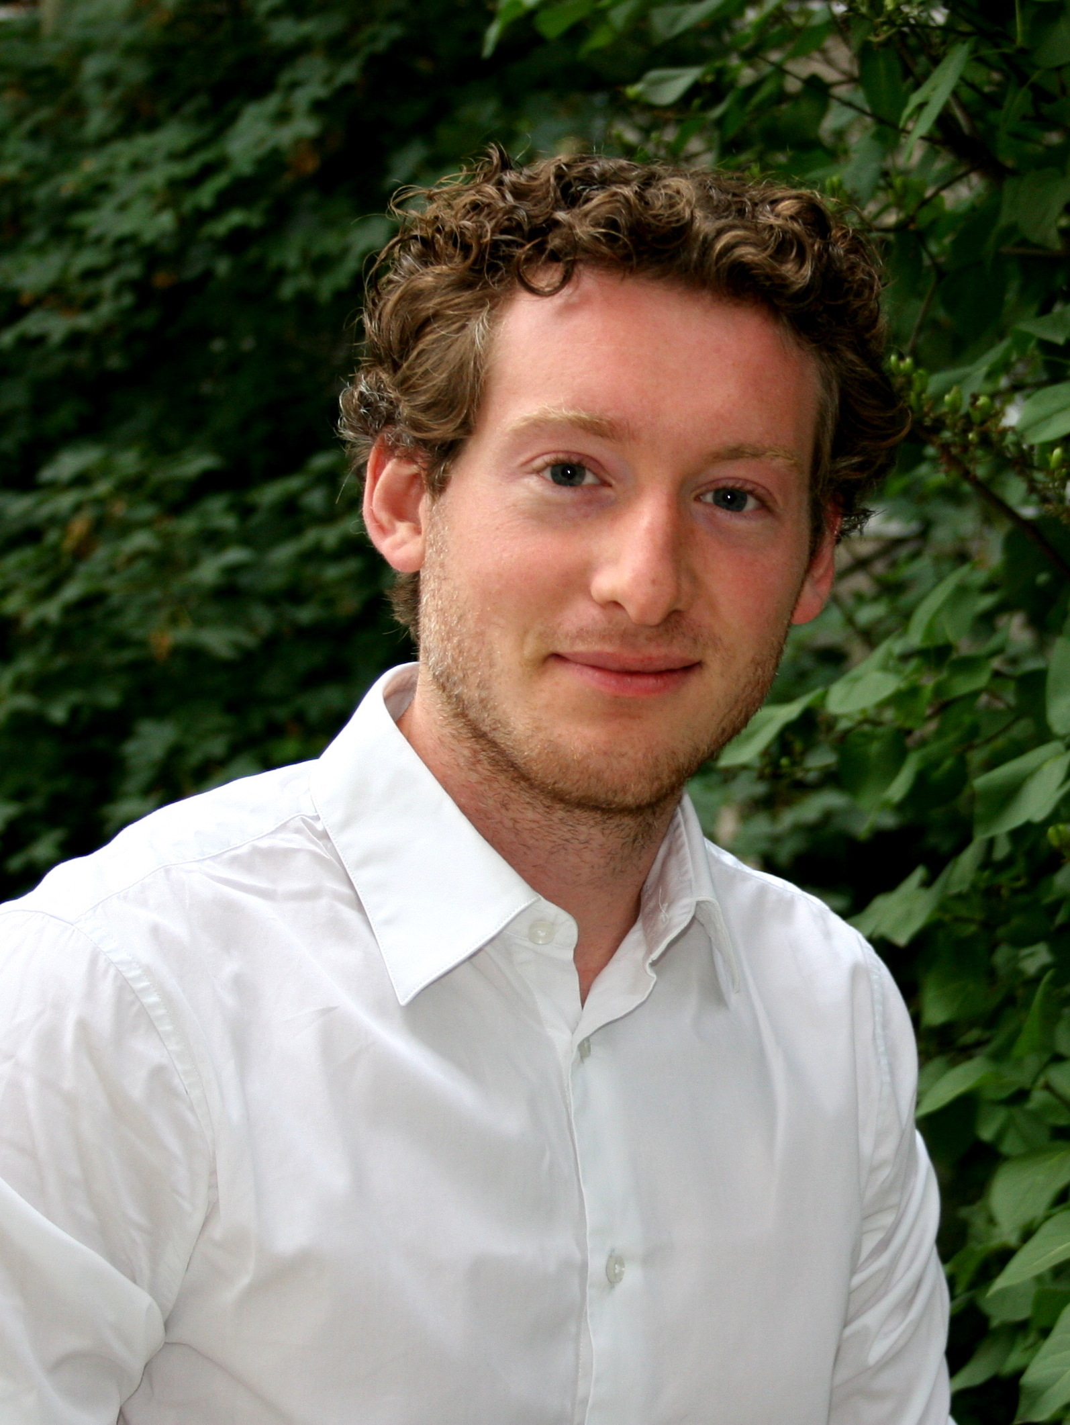
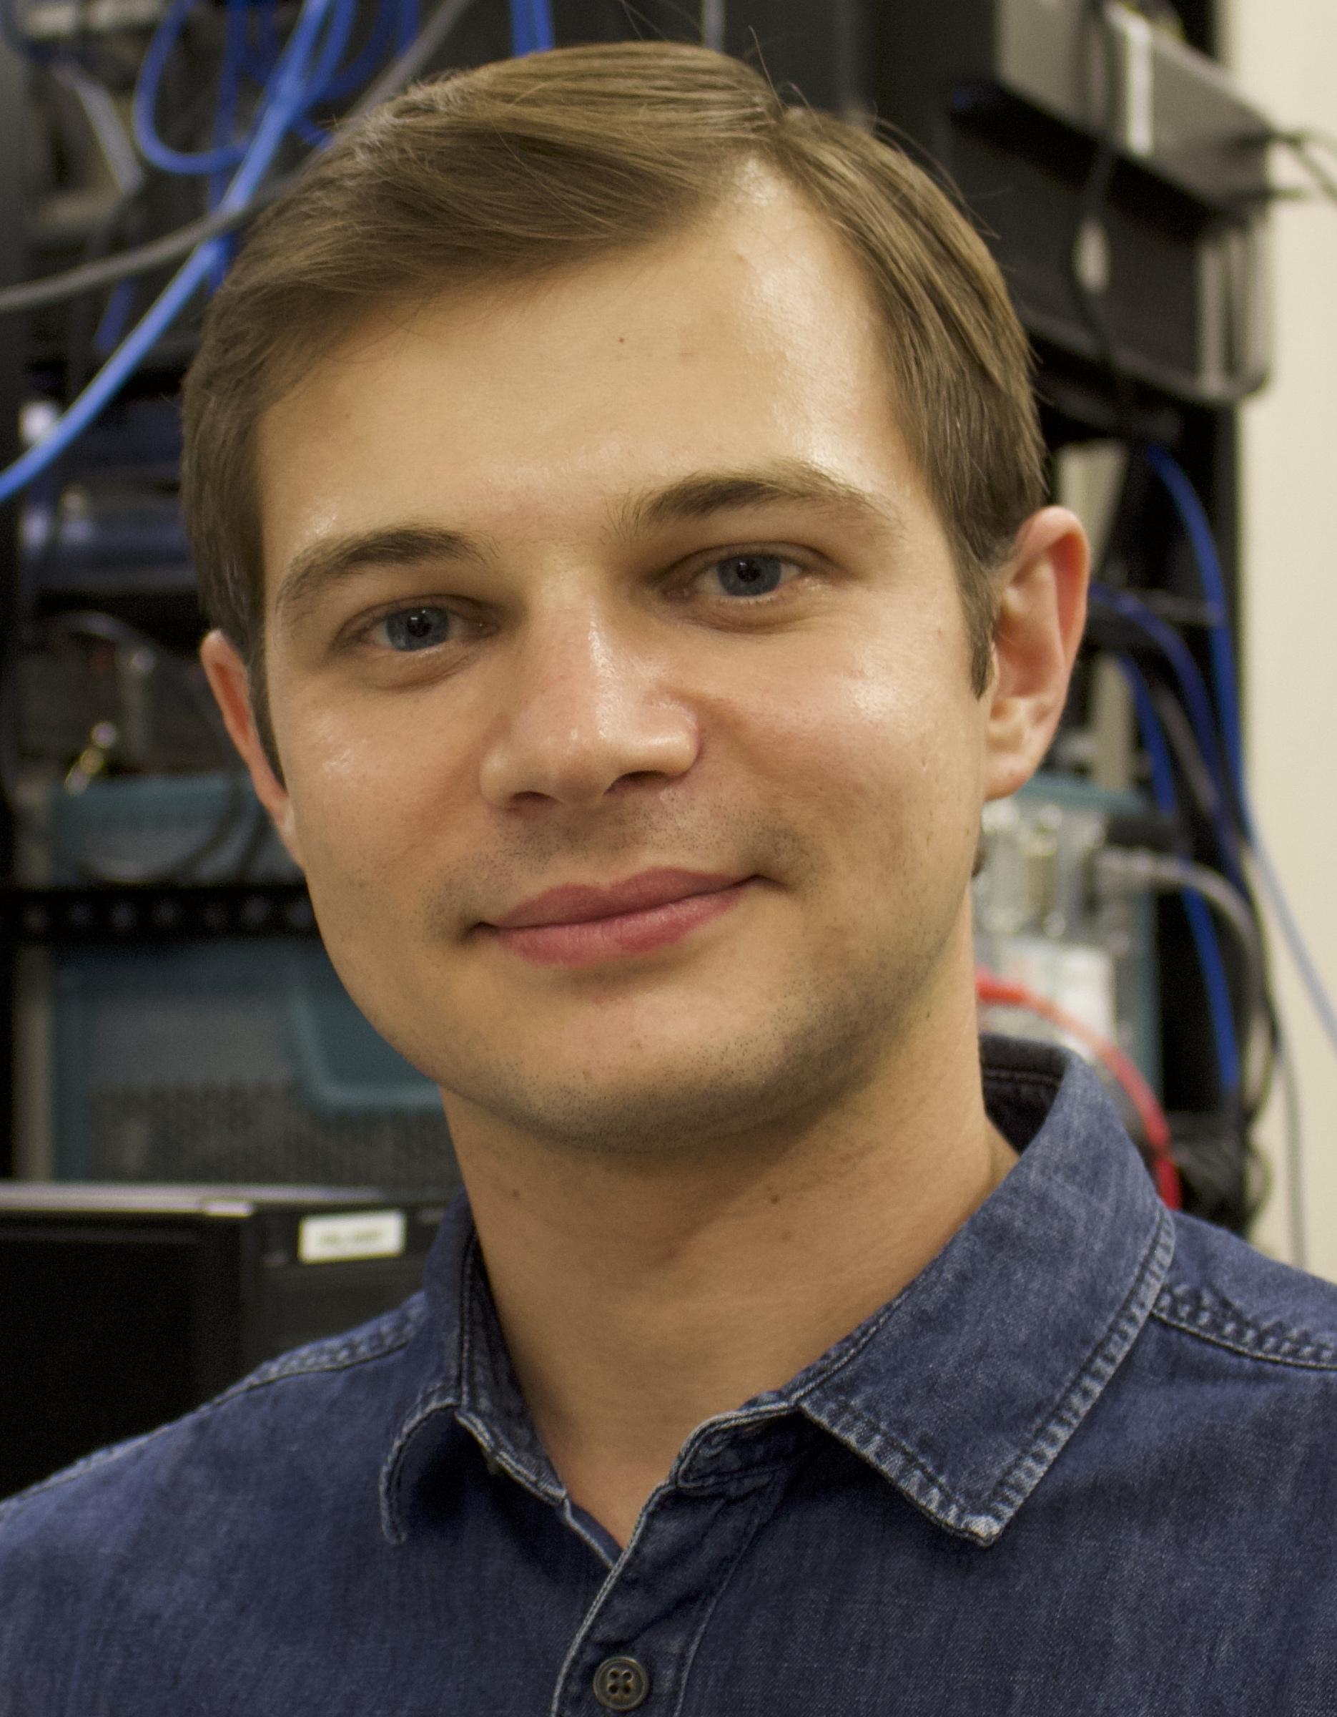
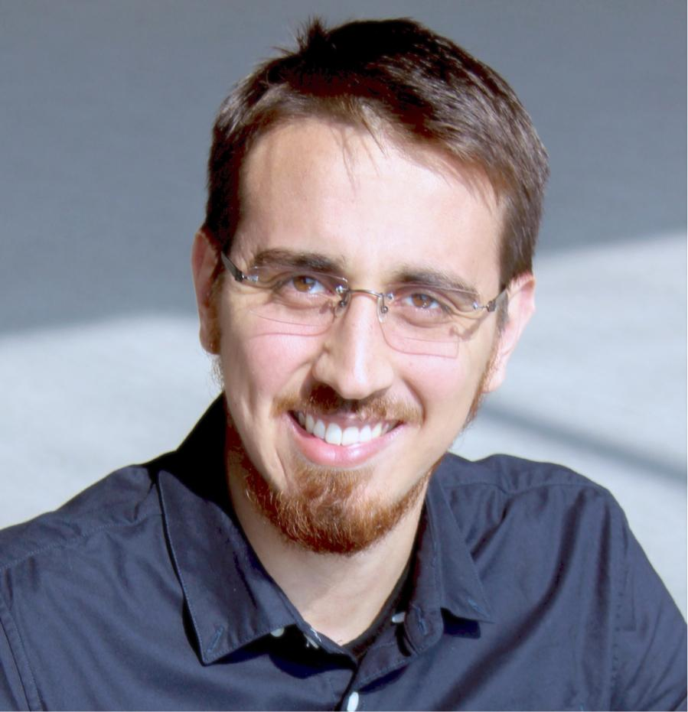
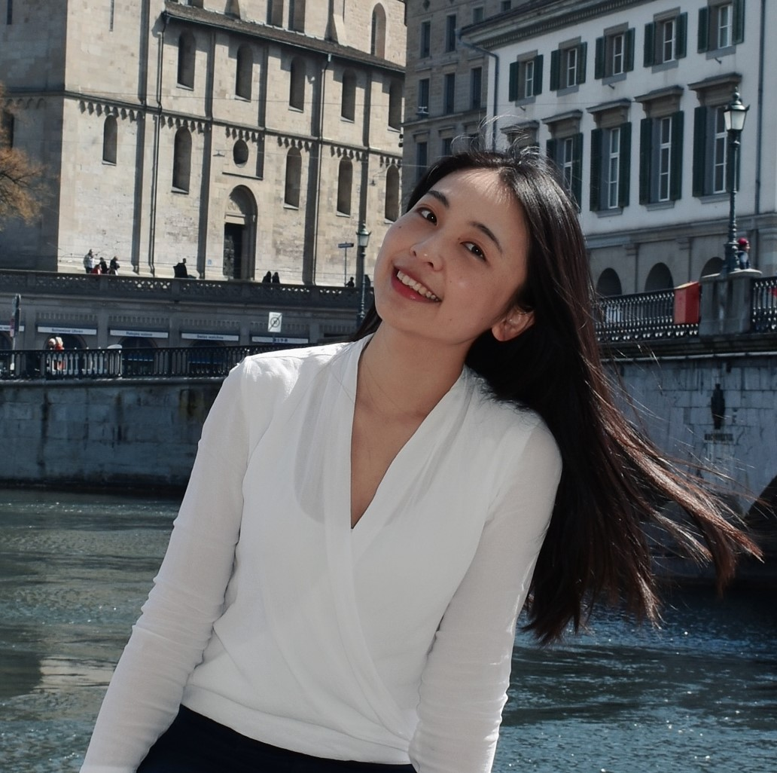
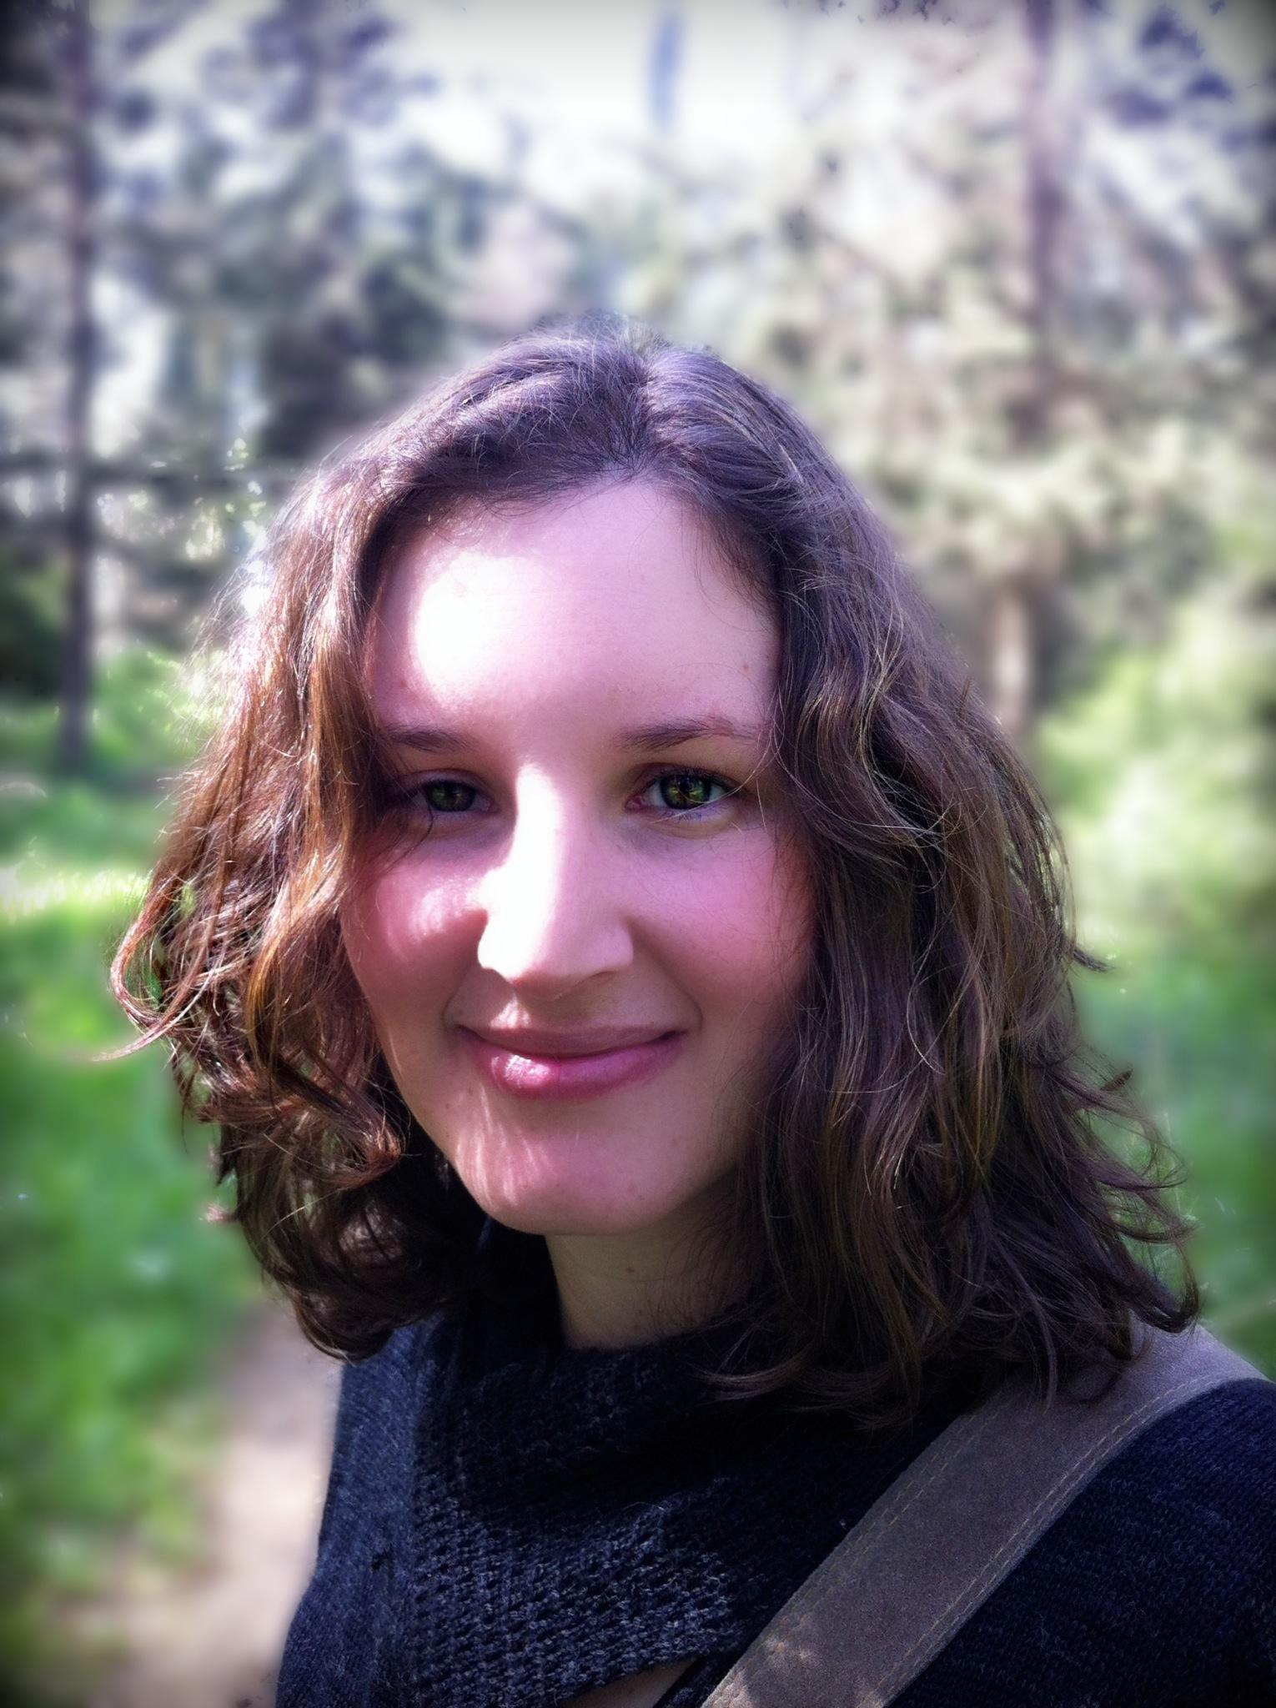
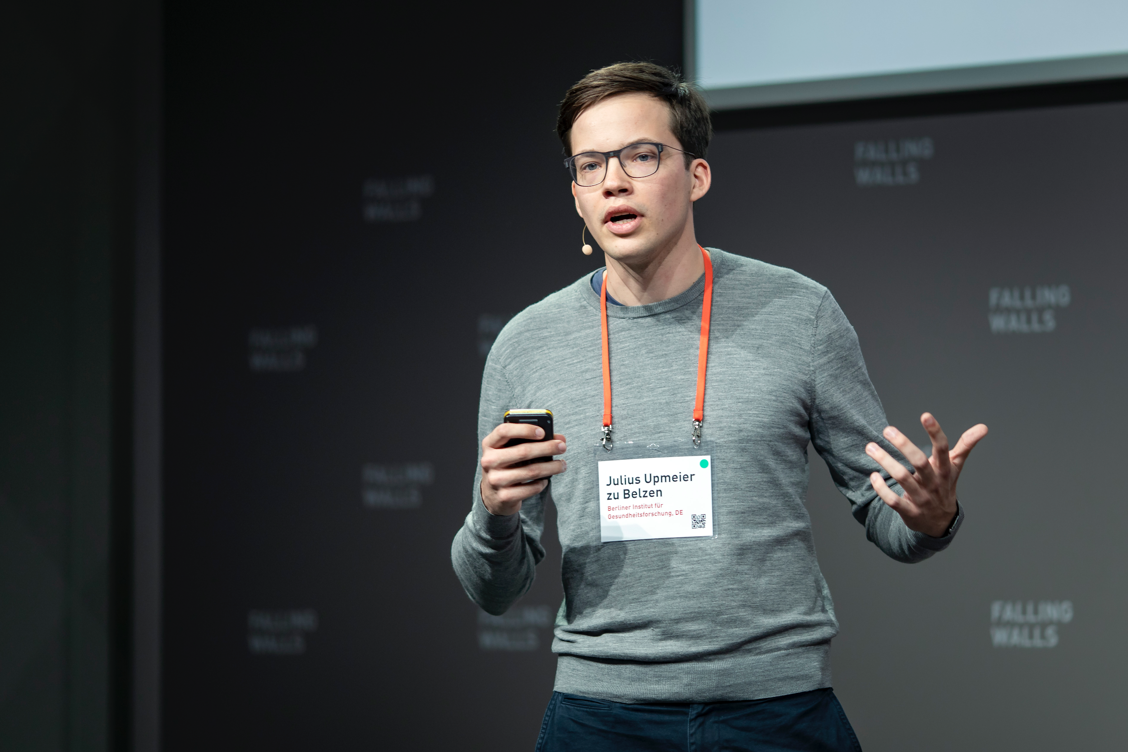
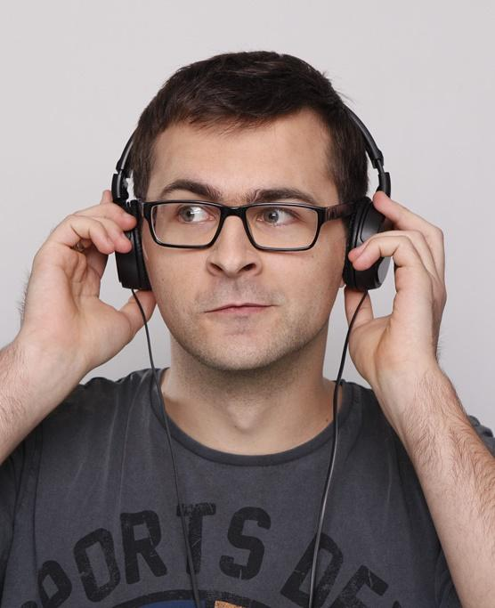
#sciathon
Climate Change Communicated in Style: A Big Data Approach to Target the Most Effective Influencers
Group Bisztray:
Marta Bisztray, Mengqiao Du, Adair Gallo Jr., Wojciech Hardy, Neta Livneh, Eugene Sachkou, Julius Upmeier zu Belzen, Lennart Ziegler
Notes:
Original idea: how to bring the message about climate change closer to people by using the help of those who do influence the way people think and behave. If people don’t listen to rational arguments, they can still follow what their role model does. How to use this for good, and how to take advantage of our knowledge as scientists and economists in this process
Great experience to work with our team and see how the original idea evolved within 48 hours.
As a result we propose an approach about how to communicate and leave room for others to tell what exact message should be.
---
Introduction
... The scientific community
Maybe we should mentions other finalists (and groups that didn't reach the finals) - how our goal is to create a tool for them.
Also mention the lindau comunity.

Slide 2
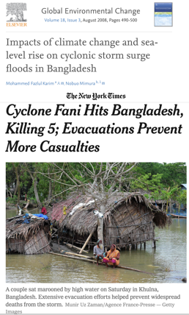
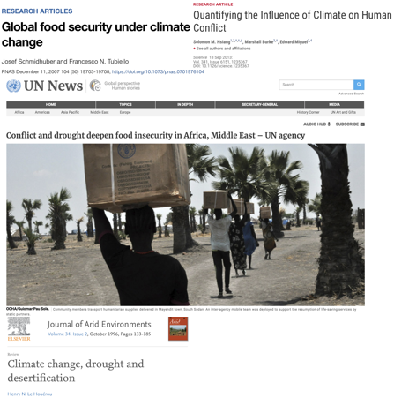
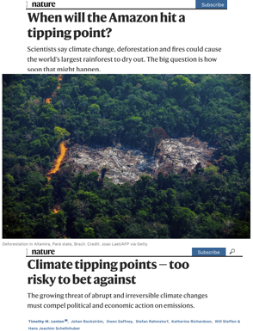
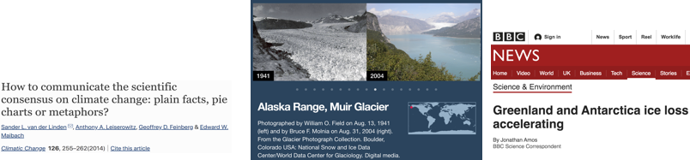
Notes:
There is no need to emphasize the long-term consequences of climate change and the need for action against that in this community. We know that.
There are many scientific papers and articles in prominent journals on this topic. Some peolpe already experince the effect but there are many who do not and therefore don’t think that it’s important.
We need to raise awareness and promote action, but for that we need a better way to communicate
---
Barry Barish and other lauerets, policies don't understand science... so scientist need to lobby their ideas.
Maybe this is related to our approach, as we are suggesting another raute to create policy change.
(One short slide on the long-term consequences of climate change... just citing examples.. And the importance of the general public in driving change. (maybe just impressive pictures? We should be able to get some of flooding etc from wikimedia; comparable to the ‘messages to convey’ slide)
Importance of climate change, but many people not yet being affected just don't care – though they are needed for a change.

Slide 3
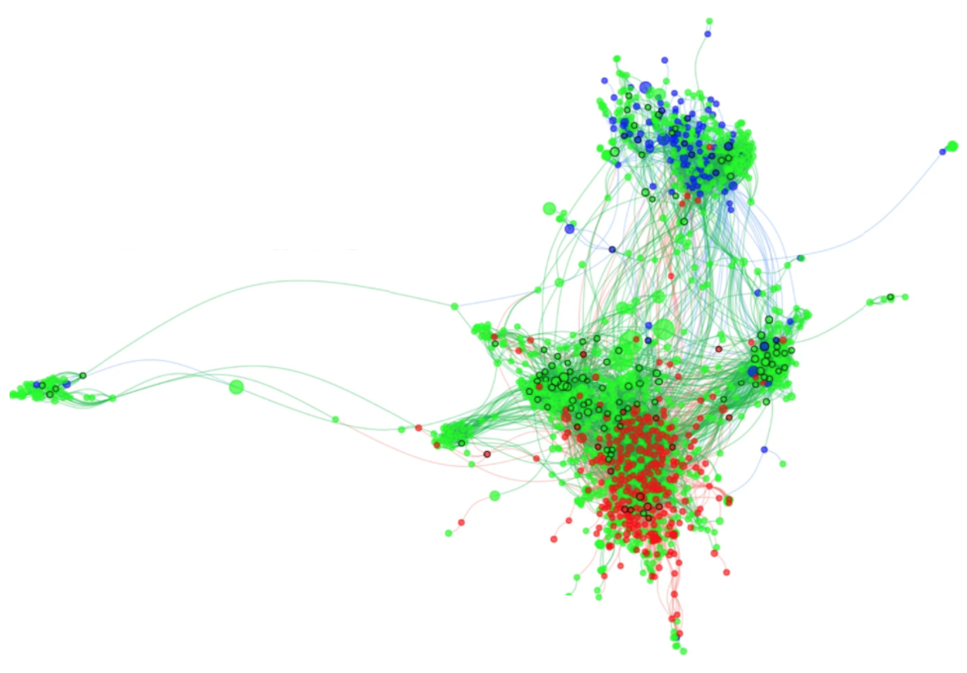


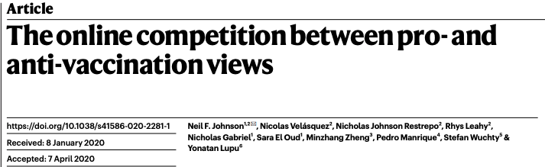
Who to target?
+
Pro-vaccine
Undecided
Anti-vaccine
-
?
?
?
?
Johnson, N. F., Velásquez, N., Restrepo, N. J., Leahy, R., Gabriel, N., El Oud, S., ... & Lupu, Y. (2020). The online competition between pro-and anti-vaccination views. Nature, 1-4.
Notes:
How people
We can learn a couple of lessons from this 2020 Nature study on pro- and anti-vaccination views:
[Click]
Clustering of people sharing the same view with little connections to people with opposing views. Evidence from social media.
[Click]
Importance of undecided - Most people are undecided, not passive, threat of turning to deniers.
---
We can learn a couple of lessons from this 2020 Nature study on pro- and anti-vaccination views:
[Click]
And we can see the bubbles we mentioned earlier, that have little connection to each other
[Click]
Most people are undecided

Slide 4
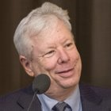
Motivation
Scientist and activist
Science follower
Greta Thunberg: CC BY-SA 4.0 by Anders Hellberg; Richard H. Thaler: CC BY-SA 2.0 by Bengt Nyman
Notes:
It has already been mentioned multiple times in OSD that proper communication of scientific results is crucial, so that we can have an impact on the choice of individuals and also on policies. Many of us are not very good at that. Even famous scientists and well-known climate change activists have limited links to the general public. [X]
---
The scientific community is at the forefront of the battle, but the link between the academic network and the general public is limited. [X]
... If scientists could

Slide 5
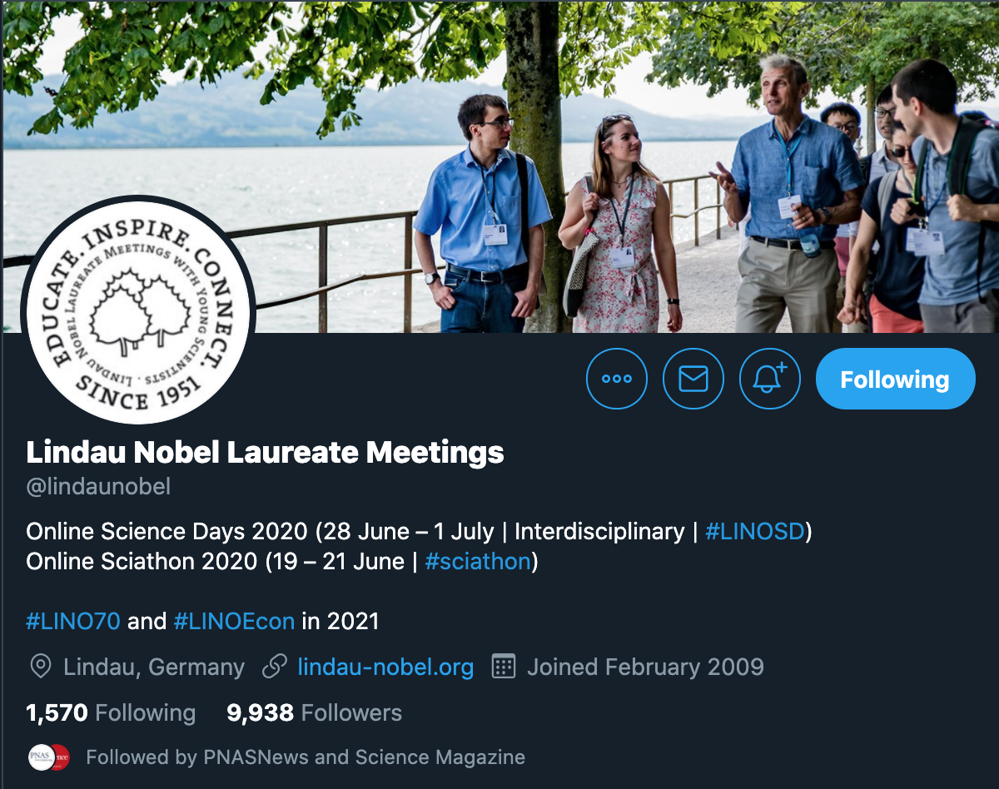
General
public
Scientist
or activist
Science
follower
Influencers
Notes:
If scientists could broadcast their ideas through someone – intermediaries - who can reach out to a much wider audience [X], that would help to raise awareness.
Our idea is to involve relevant influencers who can help us in communicating the importance of climate change [X].
Imprtant questions to asnwer: How to reach out to them, what message they should convey, how to identify the influencers with the highest potential, how to make this a long-lasting mechanism (institutionalize)?
We hope, with the support of the Lindau network including Nobel laureates, we can attract the attention and interest of these influencers. [X].
---
If scientists could broadcast their ideas through someone who can reach out to a much wider audience [X], that would help to raise awareness.
Our idea is to involve relevant influencers who can help us in communicating the importance of climate change [X].
We hope, with the support of the Lindau network including Nobel laureates, we can attract the attention and interest of these influencers. [X].
... And although it’s not straightforward

Slide 6
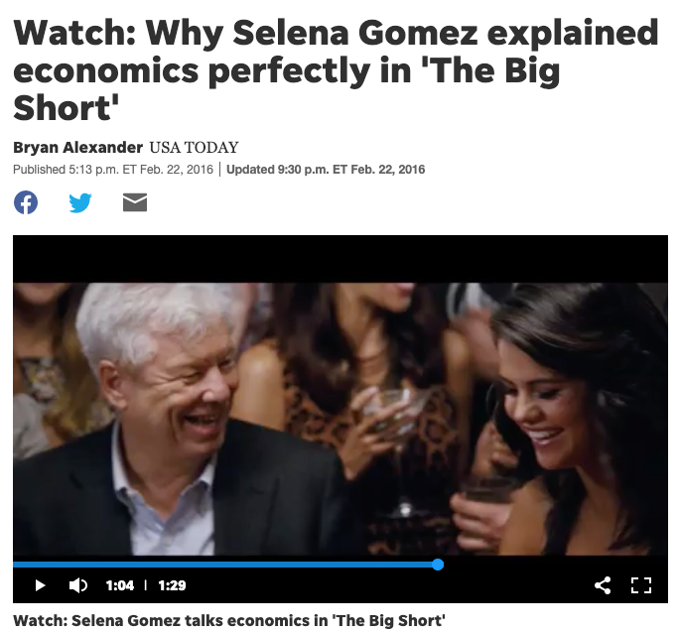
Notes:
An example which shows that there are already existing links between Nobel laureates and influencers. But prestigeous scientists and economists can help to establish new links. Additionally, the example also shows that an influencer sending the message can be powerful.
---
https://www.usatoday.com/story/life/entertainthis/2016/02/22/watch-why-selena-gomez-explained-economics-big-short/80769978/
Lindau network can help in the first step of reaching out to influencers.

Slide 7
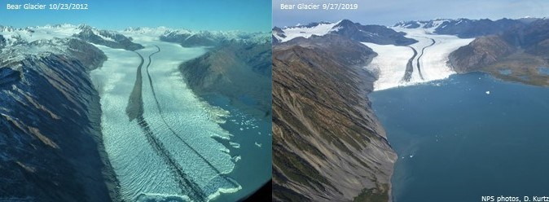
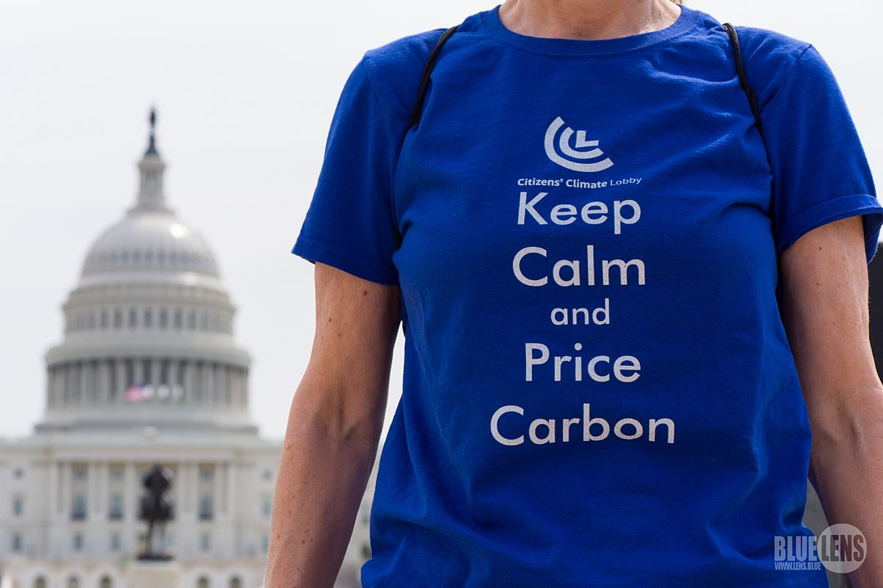
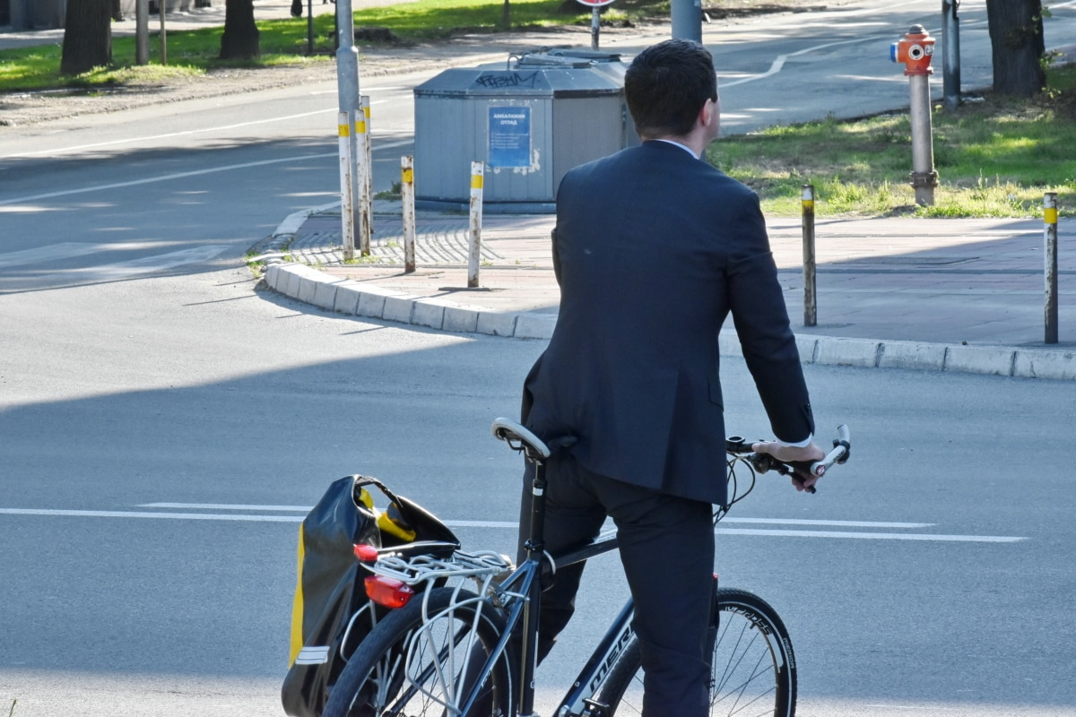
Messages to convey – what and how?
Aerial photos of Bear Glacier taken from approximately the same location, on October 2012 (left image) and on September 2019 (right image). NPS Photos/D. Kurtz
Wikimedia commons DC-Climate-March-2017-1510585
What are your ideas, what should be communicated?
CHALLENGE
Bicanski, pixnio.com
Notes:
What kind of message do we think about? Ultimate goal is to change the attitude + call for action. Raise awareness. Start small: make a certain behaviour popular. Doing something matters. Challenge as a potential starting point. Here come the ideas of the other groups.
Influencers know it better how to approach their followers.
---
Ultimate goal is to change the attitude + call for action. Start small: make a certain behaviour popular. Doing something matters. Challenge as a potential starting point. (We can also mention the ideas of the other groups as well, or come back to that point later at the end.)

Slide 8
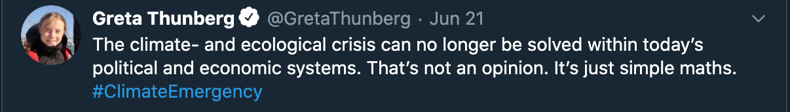
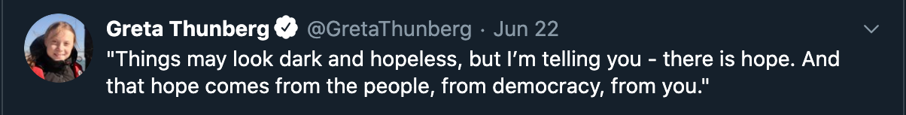
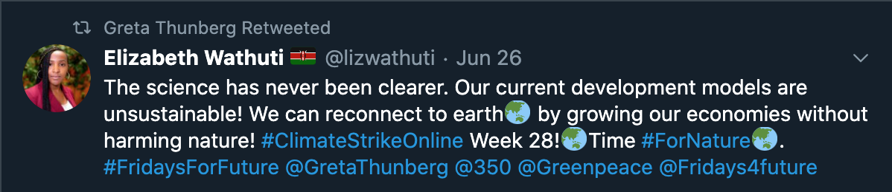
Intuition for our Method
climate
#ClimateEmergency
Greta Retweeted
#ClimateStrikeOnline
Notes:
What we want to stress
We analyze tweets of an account to search for tweets about climate change
Here you can find 3 tweets by Greta Thunberg. The first tweets is about Climate Change, as can be seen by the word climate in the text, and by the hashtag #cliamteEmergency.
The second tweet is actually to about the subject while the third retweet (that we also analyze, is).
In this small analysis, 2/3 of Greta's tweets are directly about climate change so unsurprisingly, she is not the right influencer for us.

Slide 9
Pilot approach
Note: start with screenshots from Gretas account
...
for phrase in tweet:
if phrase in {'climatealarmism', 'globalwarminghysteria‘, 'nca4', 'gobalchange', 'climatechangecult‘, 'globalwarmingscam', 'climatechangefraud‘, 'climatescam', 'climateemergency‘, 'gretathunberg', 'climatestrike‘, ...}:
climate_change_tweets += 1
...
Notes:
Text suggestion: Another option is to start from a real twitter account. Maybe Paul Krugman? While also targeting his tweets about tweets of followers?
Say we have one account here, we focus on
[click]
We look at the most recent tweets (200 actually)
[click]
And then, by simple string matching we identify the ones about climate change
[click]
50 % in this example

Slide 10
Pilot approach
50 %
Notes:
Text suggestion: In the next step, we look at the followers of an account, currently 200.
[click] And again identify tweets that mention climate change
[click]
Here, we count an account as interested in the climate change topic when it has at least one tweet on climate change
[clicck]

Slide 11

Pilot approach
Focus efforts on high-potential account
75 %
75 %
25 %
50 %
0 %
0 %
Audience already engaged
Little influence on audience
High potential reach on climate change
Notes:
So the climate change metrics for this account would be that 50 % of the recent tweets are about climate change, and 75 % of its followers are interested in climate change.
[click]
If we compare these metrics across accounts, we can learn a couple of things:

Slide 12
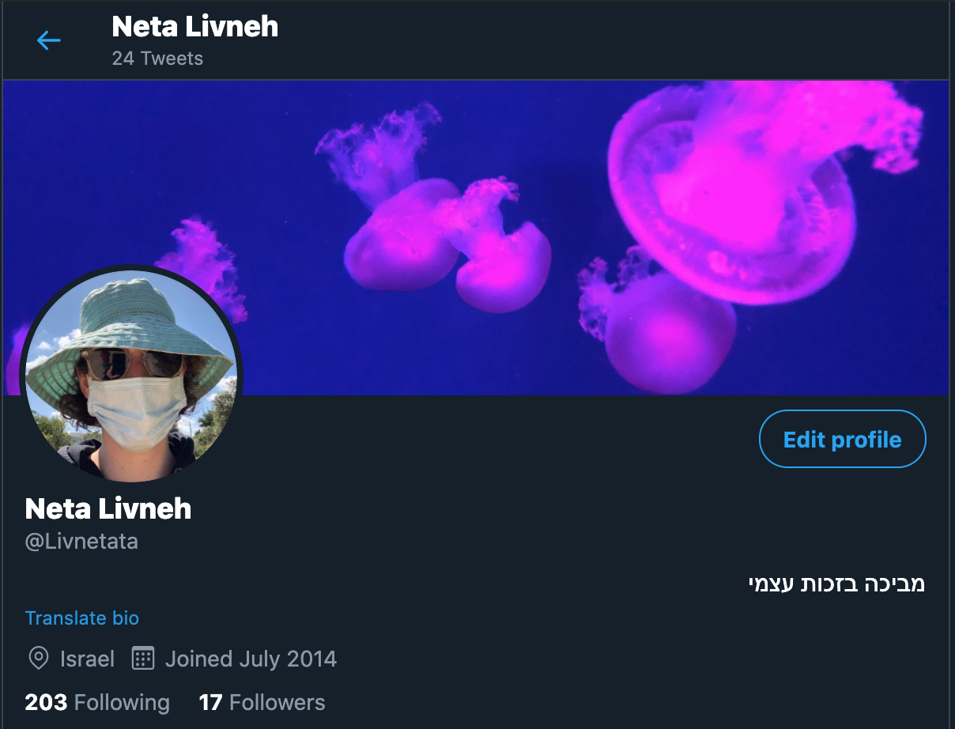
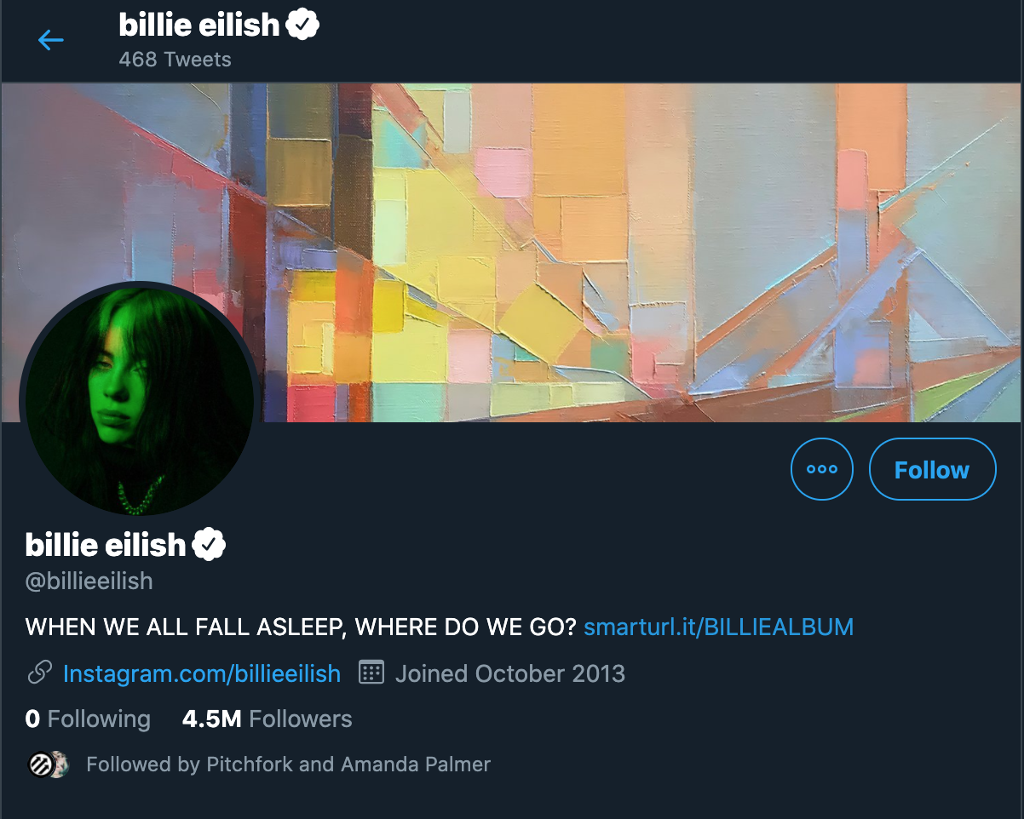
Pilot results
Description of the metrics
Explanation of the results
Reach
Communicating Climate Change
Followers Interest
Followers: 17
CC Tweets: 0%
Followers CC tweets: 0%
Followers: 4,525,681
CC Tweets: 0%
Followers CC tweets: 4%
Find the raw data here: https://charitede-my.sharepoint.com/:x:/g/personal/julius_upmeier_charite_de/ESH0N2qpL2VEt3Ic5sGx4jsB1Hn4615N7HJeY16TvsHN2A?e=efLkRf
And sorry for the mess
Notes:
Find the raw data here: https://charitede-my.sharepoint.com/:x:/g/personal/julius_upmeier_charite_de/ESH0N2qpL2VEt3Ic5sGx4jsB1Hn4615N7HJeY16TvsHN2A?e=efLkRf
And sorry for the mess
Text idea
First, we quantify reach by simply taking the follower account
[click]
This is Netas account from our group before the sciathon. Now, of course she has more followers and tweeted abut climate change. This also explains, why we ourselves are probably not the ideal communicators.
[click]
Second, we look at the current communication as explained earlier. So this is the percentage of tweets mentioning climate change of each account
[click]
This immediately let’s us know, that people like Greta Thunberg can hardly increase their communication on climate change to reach more people.
[click]
So finally, we looked at the current interest in climate change in the audience. Keep in mind, we want to target audiences who are not decided yet. In other words, people who don’t tweet on climate change.
[click]
So if we combine all these requirements together, we find people like Billie Eilish. She has a wide reach, doesn’t tweet about climate change a lot, and neither does her audience.

Slide 13
Long-term plan of action
COMMITTEE Nobel laureates, distinguished scientists, economists
Recognition awards
SOCIAL MEDIA INFLUENCERS
FOUNDATION
Who to target?
DATA ANALYSTS

Slide 14
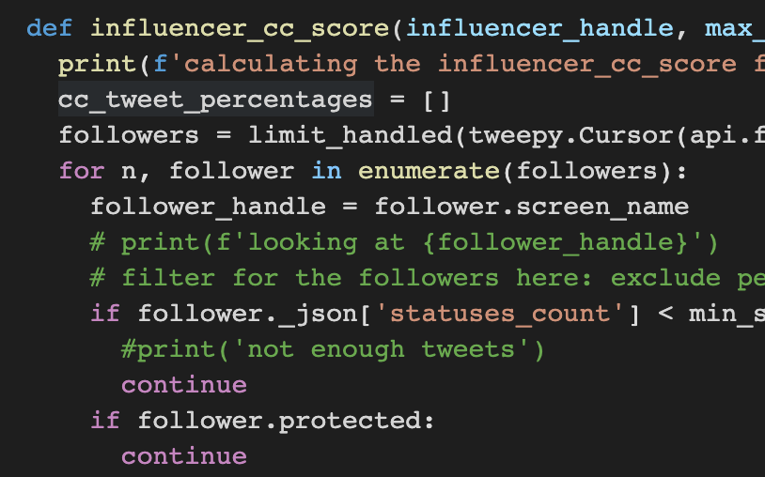
+
=
: )
Earth: CC BY-SA 4.0 by NASA/NOAA/GSFC/Suomi NPP/VIIRS/Norman Kuring
Notes:
Conclusion

Slide 15
Tell us what you want to communicate!
Adair
Eugene
Wojciech
Marta
Group Bisztray
bisztray.marta@krtk.mta.hu
Lennart
Lennart
Neta
Julius
Mengqiao
Notes:
Acknowledgements
+ reach out to us with your ideas!

Slide 16
Adair
Eugene
Wojciech
Marta
Lennart
Neta
Julius
Mengqiao
Notes:
Acknowledgements

Slide 17
Video Slides
For copy-paste-action

Slide 18
#sciathon
Climate Change Communicated in Style: A Big Data Approach to Target the Most Effective Influencers
Group Bisztray:
Marta Bisztray, Mengqiao Du, Adair Gallo Jr., Wojciech Hardy, Neta Livneh, Eugene Sachkou, Julius Upmeier zu Belzen, Lennart Ziegler
Notes:
Efficient communication is key in combatting climate change. [X]
... The scientific community

Slide 19
Scientist
or activist
Science
follower
Greta Thunberg: CC BY-SA 4.0 by Anders Hellberg
Notes:
The scientific community is at the forefront of the battle, but the link between the academic network and the general public is limited. [X]
... If scientists could

Slide 20
General
public
Scientist
or activist
Science
follower
Influencers
Notes:
If scientists could broadcast their ideas through someone who can reach out to a much wider audience [X], that would help to raise awareness.
Our idea is to involve relevant influencers who can help us in communicating the importance of climate change [X].
We hope, with the support of the Lindau network including Nobel laureates, we can attract the attention and interest of these influencers. [X].
... And although it’s not straightforward

Slide 21
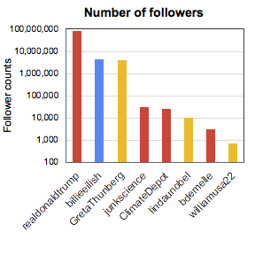
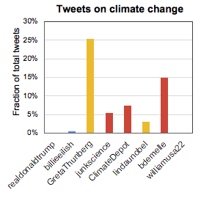
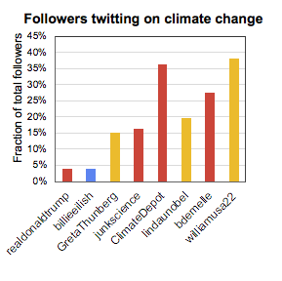
General
public
Influencers
Notes:
And although it’s not straightforward who to target, network analysis can help us. Using public information on Twitter accounts we can find those influencers that have the highest potential. Our idea is to identify the influencers who have many followers that are not yet interested in climate change.
... Nowadays, many people

Slide 22
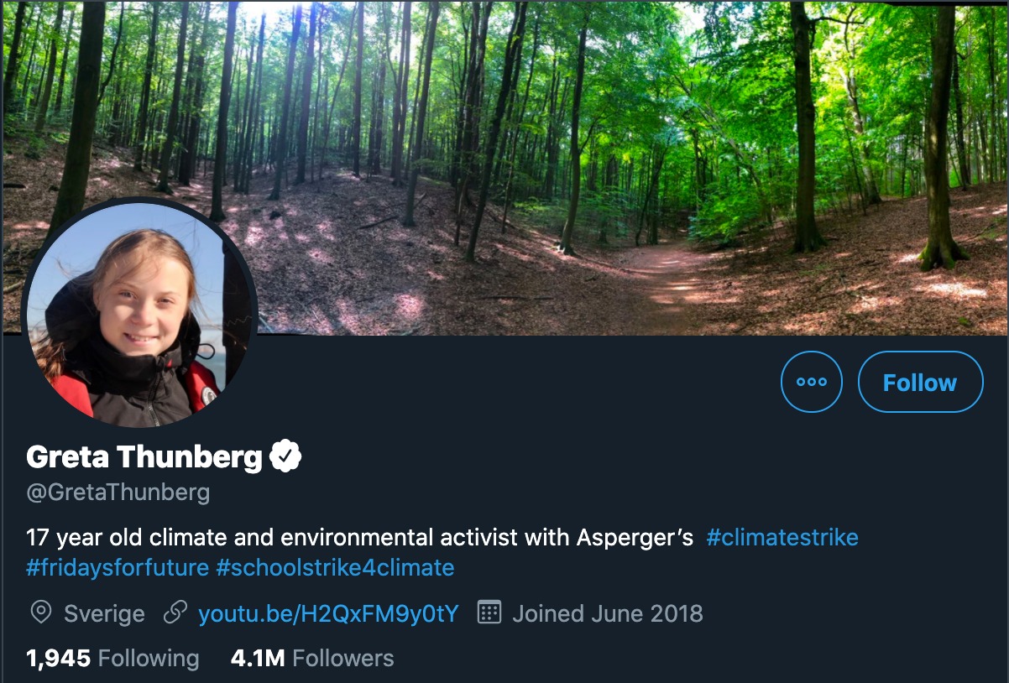
Followers: 17
CC Tweets: 0%
Followers CC tweets: 0%
Followers: 4,155,582
CC Tweets: 25%
Followers CC tweets: 15 %
Followers: 9,939
CC Tweets: 3%
Followers CC tweets: 20%
Followers: 4,525,681
CC Tweets: 0%
Followers CC tweets: 4%
Notes:
Nowadays, almost everyone has a twitter account, but with very different numbers of followers [X]. Still, the number of followers in itself is not enough for our purpose. The many followers of Greta Thunberg are already convinced about the importance of climate change. [X]
... We would rather [X]

Slide 23

Followers: 4,525,681
CC Tweets: 0%
Followers CC tweets: 4%
Notes:
We would rather like to target someone like Billie Ellish, who hasn’t tweeted about climate change recently and the same is true for most of her folllowers. [X]
... Combining the ability of

Slide 24
+
=
: )
Earth: CC BY-SA 4.0 by NASA/NOAA/GSFC/Suomi NPP/VIIRS/Norman Kuring
Notes:
Combining the ability of the Lindau community to reach out to influencers and a data-driven approach to identify relevant influencers, we hope, we can raise awareness that goes beyond our scientific bubble.

Slide 25
Adair
Eugene
Wojciech
Marta
Lennart
Neta
Julius
Mengqiao
Notes:
Combining the ability of the Lindau community to reach out to influencers and a data-driven approach to identify relevant influencers, we hope, we can raise awareness that goes beyond our scientific bubble. – And see you in Lindau!

Slide 26



Who to talk to?
+
+
?
-
Influencer account
?
?
?
Convinced about climate change already
Convinced climate change is a hoax
Has no clear position (yet)
Convinced, climate change is important (now)!
Notes:
Undecided are important, as 1. it's easier to persuade them than the convinced deniers, 2. there are many, 3. their voice is needed for having an increased pressure on policymakers to work towards sustainable solutions in a cooperative way.
But how to reach out to the undecided?

